Slide 1

Computer Communications
& Networks
CSNC-2413
Lec: 1
Computer Networking: A Top Down Approach
6th edition
Jim Kurose, Keith Ross
Addison-Wesley
March 2012
Introduction; Edge, Access, Core N/W

Slide 2
Course Intro
Basic course in Computer Networking
Provides overview of…
  What are computer networks
  How do they operate
  How are they designed
Adopts TOP DOWN approach…
  Types/needs of the distributed applications for N/Ws
  Various layered functionalities required for remote applications to communicate
  Relevant networking protocols/standards in wired/wireless domains
Computer Networks
allow remote, distributed applications to communicate & provide variety of services

Slide 3
Course Contents
Computer Networks & the Internet
  Nuts & Bolts description
  Services description
  Network Edge & Core
  Delay, Loss & Throughput in packet switched networks
  Network architectures (TCP/IP, OSI)
Application Layer
  Network applications, principles/architectures
  Services required & made available to Apps (by N/W)
  Application layer protocols
  (Web/HTTP, FTP, SMTP, POP3, DNS)
  Apps development; Socket Programming (TCP & UDP)

Slide 4
Course Contents
Transport Layer
  Transport layer functions in Internet – Mux & de-Mux
  Connection less, unreliable transport – UDP
  Reliable Data Transfer (Go-Back-N, Selective Repeat ARQ)
  Connection oriented transport – TCP
  TCP Connection management, Flow control, Congestion Control
Network Layer
  Network service model – Datagram & VC networks
  Forwarding & routing, What’s inside a router
  IPv4 protocol, Addressing, Subnetting, CIDR
  DHCP, NAT, ICMP, IPv6 protocol
  Routing algorithms – LS/DV routing

Slide 5
Course Contents
Link Layer
  Link layer functions
  Multiple access protocols
  Link layer addressing, ARP
  Link layer Technologies
    Ethernet - IEEE 802.3 standard

Slide 6
Course Contents
Network Programming :
  Socket Programming
    Client/Server communications paradigm
    TCP & UDP client-server comm
    Iterative & Concurrent servers
    (threads & child processes)
    I/O multiplexing, select()
    Unix network programming in ‘C’
      (Socket API)

Slide 7


Books Recommended
Text:
Computer Networking: A Top-Down Approach (6th Ed)
  by James F. Kurose & Keith W. Ross
Unix Network Programming – Vol I
  by W Richards Stevens
Ref:
Computer Networking: A Systems Approach (5th Ed)
  by Larry L. Peterson & Bruce S. Davie

Slide 8
Grading Policy
Quizzes ………. 04 10%
Assignments ……… . 04 15%
Class participation ..….…. 10%
Mid-exam ..….…. 25%
Final-exam .……… 40%
Distribution is tentative and flexible

Slide 9
Academic Honesty
Your work in this class must be your own
If students are found to have:
  collaborated excessively, or
  copied/shared answers
For the first infraction…
  all involved will, at a minimum, receive grades of 0
Further infractions…
  will result in failure in course

Slide 10
Lets Start the Course…

Slide 11
Chapter 1: Introduction
our goal:
get “feel” and terminology
more depth/detail later in course
approach:
  use Internet as example
overview:
What is the Internet?
What is a network protocol?
Network Edge: hosts, access N/W, physical media
Network Core: Internet structure, packet/circuit switching
Performance: loss, delay, throughput
Protocol layers, service models

Slide 12
Chapter 1: roadmap
  1.1 what is the Internet?
  1.2 network edge
    end systems, access networks, links
  1.3 network core
    packet switching, circuit switching, network structure
  1.4 delay, loss, throughput in networks
  1.5 protocol layers, service models
  1.6 networks under attack: security
  1.7 history

Slide 13
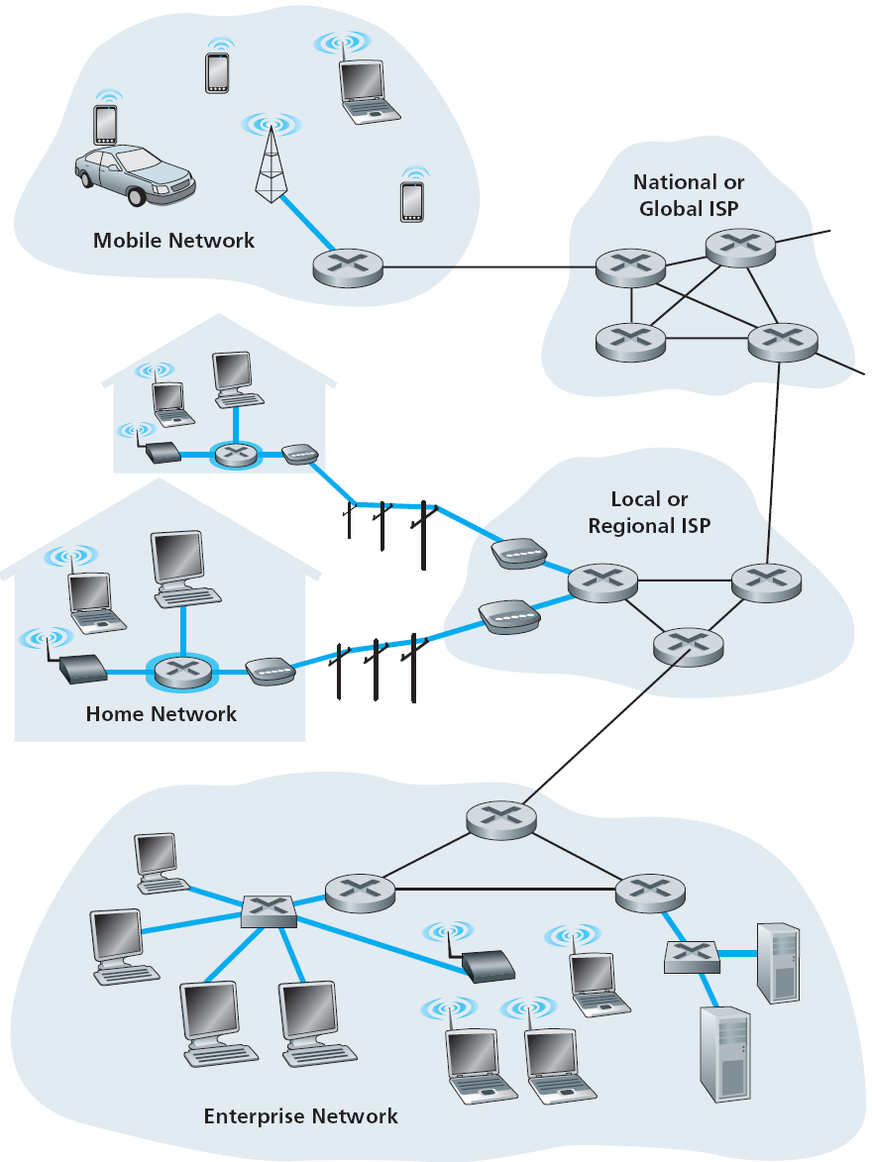






What is the Internet: “Nuts & Bolts” view
What basic components make
up the Internet…
Computing devices:
(millions are connected)
  hosts & end systems
  run network apps
  generate/use data
PC
server
wireless
laptop
smartphone
Communication links:
  copper, fiber,
  radio, satellite
  have some bandwidth (data rate)
wireless
links
wired
links
Packet switches:
forward packets (chunks
of data)
  switches & routers
router

Slide 14
What’s the Internet: “Nuts & Bolts” view
Internet: “network of networks”
  hierarchical structure
  interconnected ISPs
  (lower tier ISPs, upper tier ISPs, …)
  home N/Ws plug into ISP N/Ws
Networking “protocols”
  run at end systems & switches
  control sending/receiving of msgs
  e.g, HTTP, DNS, Skype, TCP, IP
Internet standards
  IETF: Internet Engineering Task Force
  RFC: Request for comments

Slide 15
What’s the Internet: Services view
What services are provided to Apps by Internet…
  Apps: Web, Email, VoIP, E-commerce, Internet TV/radio, audio/video on demand, video conf, online games, social nets
  Distributed Apps: involve multiple end systems that exchange data remotely
  Require different Types of Services: reliable or unreliable data delivery, thruput/delay needs, security

Slide 16
What’s the Internet: Services view
End Systems provide an interface to apps
  Network API
  “Functions” that allow “process” on source end system to…
    “connect” to Internet
    “send/recv” data
  specifies syntax of how an appl
  asks Internet to “deliver data”
  (provides options for various
  types of services …)

Slide 17



What’s a protocol?
An important buzzword in computer networking… “Protocol“
“pre-defined set of rules”
Analogy… Human protocol & Computer Network protocol…
Hi
TCP connection
request
Hi
TCP connection
response
Got the
time?
Get http://www.awl.com/kurose-ross
2 pm
<file>
time

Slide 18
Network protocols?
machines need coordination to interact with other machines
require Network Protocols…
Network protocols define…
format/order of msgs sent/received among network entities,
& actions taken on msg Tx/Rx
all communications activity in Internet governed by protocols…
  specific msgs sent
  specific actions taken when msgs recvd, or other events occur

Slide 19
Network Structure
network edge:
  end systems
    hosts, servers, apps
  access networks
    N/Ws connecting end
    systems to edge routers
    wired/wireless comm
    links
network core:
  interconnection of routers
  route pkts from src to dst host
  form network of networks

Slide 20














The network edge
End systems (hosts):
  host (run) appl programs
  e.g, Web, email
Client/server model:
  hosts act as clients or servers
  server – always on powerful machine
  client – request/receive service
  e.g, Web browser/server,
  Email client/server
Peer-peer model:
  all hosts equal
  minimal (or no) use of dedicated servers
  e.g, BitTorrent

Slide 21
Access networks
Networks to connect end systems to edge router
Several types of access networks used in various settings…
  home access
  enterprise access
  wireless access

Slide 22
Home Access
How do homes connect to Internet
Digital Subscriber Line (DSL)
Cable Internet access
Fiber-to-the-Home (FTTH)
Dial up modem
Two most prevalent ones are
DSL & Cable

Slide 23
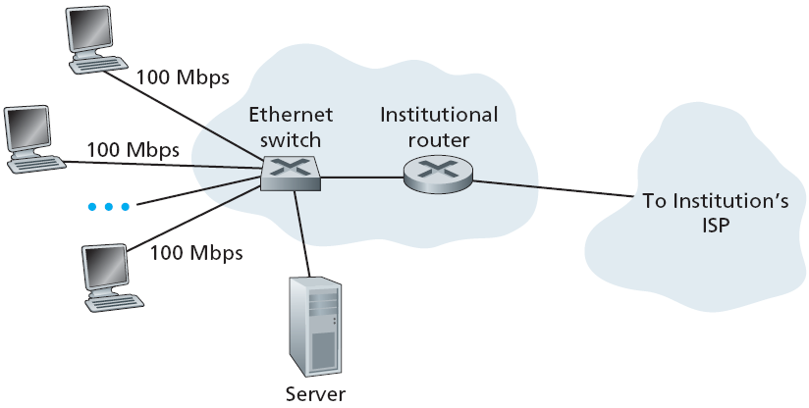
Enterprise access networks (Ethernet)
LAN used to connect end systems to edge router
Ethernet : most prevalent access N/W technology
  twisted pair copper wire & LAN switches
  typically 100 Mbps to end systems; 1 - 10 Gbps to servers

Slide 24









Wireless access networks
Shared wireless access network connects end system to edge router
  via “access point”or base station
Wide-area Wireless access:
  by cellular N/W operator
  range 10’s of kms
  data rate 1 - 10 Mbps
  3G, 4G, LTE,….
  WiMAX
Wireless LANs:
  within building (100 ft)
  802.11b/g (WiFi): 54 Mbps transmission rate
to Internet
to Internet

Slide 25
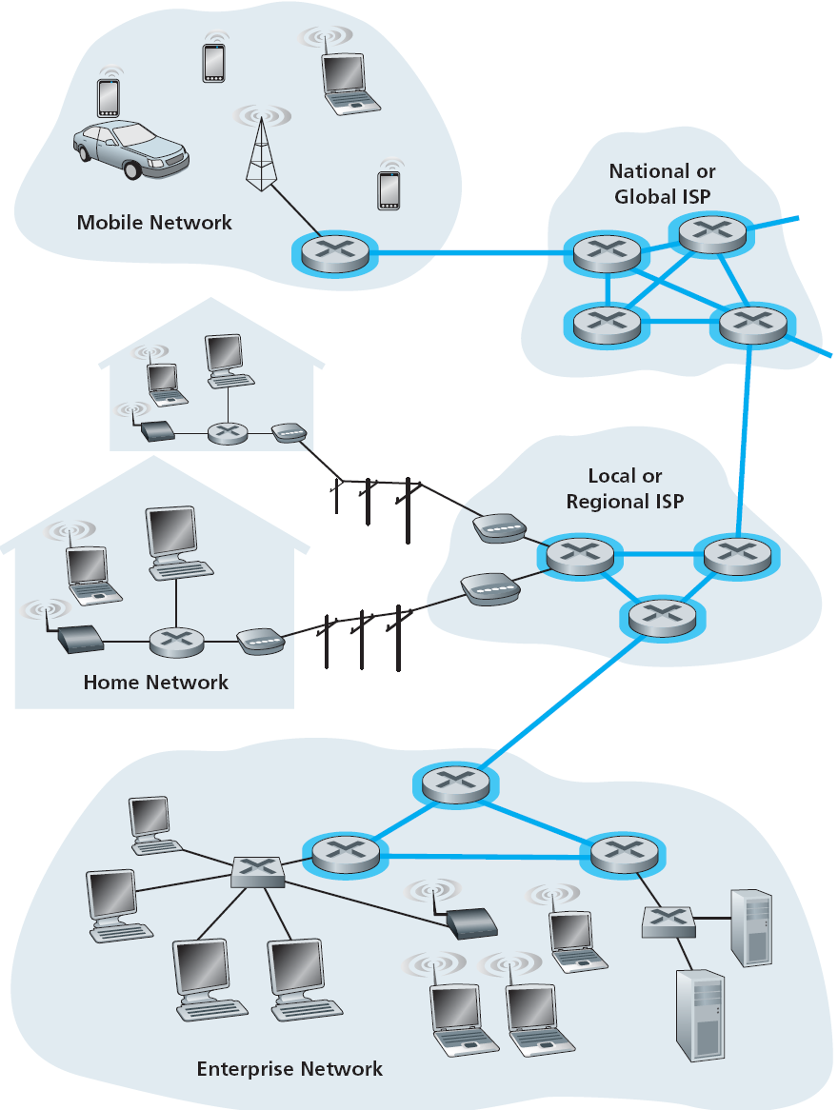
The network core
Mesh of interconnected routers
Fundamental question…
“how is data transferred thru N/W”
  Circuit switching
    resources along the path reserved for Tx duration
    e.g, telephone network
    guaranteed service
  Packet switching
    N/W resources used on demand
    e.g, Internet
    best effort service

Slide 26

Physical media: Copper
Physical medium: what lies between transmitter & receiver
carries bits - propagation of electromagnetic waves or optical pulses across physical medium
Guided media
  signals propagate in solid media
  e.g, copper, fiber, coax
Unguided media
  signals propagate freely
  atmosphere, outer-space
Twisted pair (TP)
two insulated copper wires, in spiral pattern
  Category 5: 100Mbps, 1Gpbs Ethernet
  Category 6: 10Gbps

Slide 27


Physical media: Coax, fiber
Coaxial cable:
two concentric copper conductors, with shielding
bidirectional signal flow
shared medium
end systems connected directly
high bit rates, broadband
multiple channels on cable
Fiber optic cable:
glass fiber carrying light pulses,
each pulse a bit
carry tremendous bit rates
  e.g, 10 – 100 Gpbs
long haul Tx media
low error rate:
  immune to electromagnetic noise
  repeaters spaced far apart

Slide 28
Physical media: Radio
Radio Links
Carry signals in electro- magnetic spectrum
Charateristics…
  no physical “wire”
  bidirectional
  penetrate walls
  support mobility
Propagation environment effects…
  reflection
  obstruction by objects
  interference
Radio link types
Local Area
  wireless LAN (e.g, WiFi)
  11Mbps, 54 Mbps
Wide Area (e.g, cellular)
  3G/4G cellular: in Mbps
Satellite
  link two ground stations
  geostationary vs low earth orb (LEO)
  upto 100s of Mbps speed
  upto 280 msec end-end delay

Slide 29
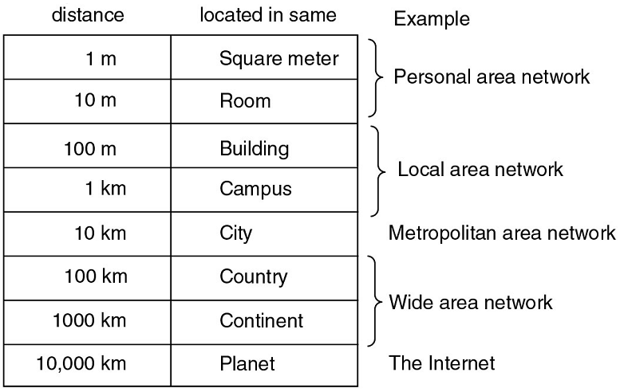
Network Categorization
Networks categorized based on their area of coverage:
  Personal Area Network
  (PAN)
  Local Area Network
  (LAN)
  Metropolitan Area Network
  (MAN)
  Wide Area Network
  (WAN)
also body area network, sensor network,
vehicular network

Slide 30
Summary
  1.1 what is the Internet?
  1.2 network edge
    end systems, access networks, links
  1.3 network core
    packet switching, circuit switching, network structure
  1.4 delay, loss, throughput in networks
  1.5 protocol layers, service models
  1.6 networks under attack: security
  1.7 history

